Slide 1


Statistics Canada’s
Demographic Estimates Program: Current Challenges, New Initiatives
Centre for Demography
September 17, 2024

Slide 2
Context: High population growth
Notes:
Enjeux liés à une forte croissance:
Besoins en infrastructures, particulièrement en logements
Pression sur nos systèmes de santé et d’éducation
Étalement urbain, environnement et développement durable
Cohésion sociale – hausse rapide de la diversité ethnoculturelle et linguistique
Permanent and temporary immigration part of census and demographic estimates universes.
8.6 million = population of Quebec.
2.9%: population doubles in about 25 years. 80 million would be reached slightly before 2050 and 100 million before 2060.
40 million Canadians reached last June.
Century initiative: 100 million in 2100. With a 2.9% growth, 100 million reached in…

Slide 3
Context: Recent increases in permanent and temporary immigration

Slide 4
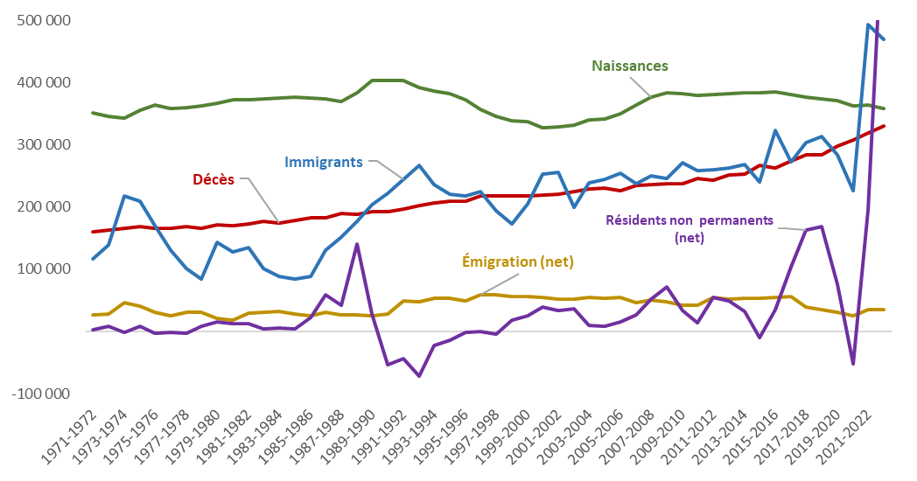
Recent demographic trends
 Components of demographic growth

Slide 5
Context: The population of non-permanent residents in Canada now surpass that of Indigenous people

Slide 6
Context: Record-low fertility levels at 1.33 children per woman
1959: 3.94
2022: 1.33
Notes:
Les conséquences:
Vieillissement démographique plus prononcé
Diminution de la taille des ménages (5 personnes en 1901 à 2,4 en 2016)
Les couples sans enfant augmentent plus rapidement que les couples avec enfant

Slide 7
Statistics Canada’s Demographic Estimates Program (DEP)
Meets legislative requirements
  Federal – Provincial Fiscal Arrangements Act (Population certificates on June 1st every year, provided to Finance Canada)
  Fair Representation Act
  Early Learning and Child Care Agreements
  First Nations Goods and Services Tax
Provides countless users with quarterly and annual population data in between censuses
  Estimates for provinces and territories
  Estimates at sub-provincial areas (such as CMAs, CD, municipalities, etc.)
  Estimates by marital status, families, and households available upon requests
  By gender and sex at birth
  Components of population growth are also of interest to many users
Meets several needs at Statistics Canada
  Total controls for social surveys including the mission-critical monthly Labour Force Survey
  Provides denominators for several key social and economic indicators such as GDP per capita, crime and health statistics, etc.
Serves as the starting point for population projections

Slide 8
A history of demographic estimates, from the Census of Population to socioeconomic indicators
Collaboration
Prov./terr.
Ext. stakeholders
Adv. committees
Federal partners
Public consultations
Intern. partners
3) SOCIOECONOMIC INDICATORS
1) CENSUS
2) DEMOGRAPHIC ESTIMATES
Collection
Federal-Provincial Fiscal Arrangements
Act
Denominators
Crime rates, life expectancy, GDP/capita, etc.
Dissemination
Published census counts
Population estimates
Coverage evaluations
Coverage adjustments
Dem. control totals
LFS and
other social surveys
Fair Representation
Act
+
Other programs needs
Components of demographic growth
Population
projections
Natural increase (births, deaths)
International migration
Interprovincial migration

Slide 9
Statistics Canada’s Demographic Estimates Program (DEP)
Target population (same as census program)
  People who have in Canada their usual place of residence
  Includes Canadian citizens, permanent immigrants and non-permanent residents
  Excludes tourists, including those with a visitor visa
Data integration program
  Base population is the census + coverage ajustments
  Components of population growth (fertility, mortality, migrations) are computed using
    Vital statistics (births and deaths)
    Canada Revenue Agency data (internal migrations)
    Immigration, Citizenship, and Refugees Canada (permanent and temporary immigration)
    US Homeland Security (emigration)
    Other data sources for validation (Census, Canada Post, etc.)
Demographic estimates follow a cycle:
  Postcensal Preliminary Estimates (when all final components are not available yet, some are modelled at this point)
  Postcensal Revised Estimates (usually one year after reference date)
  Postcensal Final Estimates (usually two years after reference date)
  Final Intercensal Estimates (after each census, for the period between two censuses)

Slide 10
Statistics Canada’s Demographic Estimates Program (DEP)
Very high quality
  Estimates are benchmarked following every census
  Differences between estimates and new census + coverage adjustments < 1% for the majority of provinces and territories
  Very high quality of the estimates during cycle 2016-2021 despite the COVID-19 pandemic
Methods are updated on a on-going basis
  Always looking for new/additional data sources (recent example Exit&Entry database from CBSA)
  Collaboration with international partners such as other NSOs to enrich the program
Based on a strong relationship with
  Data providers
  Provincial and Territorial Statistical Focal Points through the annual FPT meetings
  Data users (Fed. departments such as Finance Canada, municipalities, private sector, etc.)
  Both programs of estimates and projections also benefit from the Advisory Committee on Demographic Statistics and Studies

Slide 11
DEP’s “Error of Closure” Quality Indicator
Error of closure
Estimated growth (DEP)
2021 CNU
Variance associated with Census net undercoverage
2016 CNU
2021 Census
2016 Census

Slide 12
The 2021 errors of closure were between -1% and 1% for 9 out of 14 jurisdictions (including Canada)
Error of closure for Canada: -0,11%, representing 41,000 people.
* | = Statistically significant EC (95%) (combined 2016/2021 variance).
12

Slide 13
Estimates of non-permanent residents (NPR) in the DEP
Many data sources for NPR at Statistics Canada – not comparable!
  Census of population (every 5 years)
  DEP (quarterly and annual)
  Longitudinal Immigration Database (IMDB)
  Surveys (LFS, etc.)
  Administrative data (tax files)
NPR at Statistics Canada includes:
  Work and/or study permit holders and their family members
  Expired permit holders in the process of renewal
  Asylum claimants, protected persons, and related groups
IRCC data related to temporary residents
  Excludes family members of permit holders
  Excludes protected persons, and related groups
  Includes visitors (tourists) and visas holders

Slide 14
Estimates of non-permanent residents (NPR) in the DEP
NPR at StatCan
Temporary Residents at IRCC
Family members of work/study permit holders
People with an expired permit, in the process of renewal
Protected people, other related groups
People to Canada under CUAET
Work/Study Permit Holders
Asylum Claimants
Visitors to Canada (visas and supervisas)

Slide 15
Statistics Canada uses robust, validated methods to produce demographic estimates on NPRs
1.
Acquiring IRCC monthly files
2.
Processing
3.
Demographic adjustments
4.
Validation of
the results
5.
Estimated number of NPRs
Transactional files
Data processing
Validation with published IRCC
tables
Family members of permit holders
(e.g., Ukrainians)
Persons with expired permits in process of renewal
Demographic comparisons
Comparisons with other socioeconomic indicators
Many data tables available

Slide 16
Estimates of non-permanent residents (NPR) in the DEP
Many improvments in the last 12 months
  September 2023
    New data tables on NPRs by permit type, also showing stock of NPRs in the country
    Updates to the methods, notably related to IRCC processing times
  June 2024
    Concepts alignment on asylum claimants, protected persons, and related groups
  September 2024
    New table on NPRs stocks by age and gender
    Updates to the methods for place of residence of NPRs
Next improvments currently planned
  Exit&Entry database to improve estimates of international migrations, including emigration
  Review of the place of residence of permit holders
  Further disaggregation of asylum claimants group

Slide 17
Update to the method for place of residence of asylum claimants
Current method: intended place of residence (source: IRCC)
For NPR in particular, intended place of residence do not actually match actual place of residence
Updated method: use of last known place of residence (source: IRCC)
  The date of last known place of residence is choosen given the reference date of the demographic estimates
Comparison with the 2021 Census
17

Slide 18
Population Estimates for the Labour Force Survey (LFS)
Used as total controls to weight the LFS sample on a monthly basis
Estimates for LFS are different
  Exclude 4 specific populations: persons living on reserves and other Aboriginal settlements in the provinces; full-time members of the Canadian Armed Forces; the institutionalized population; and households in extremely remote areas with very low population density
  Methods are adjusted for a monthly production and to meet the survey’s goals
  Population data from the LFS is not comparable to the demographic estimates

Slide 19
Next Steps – Key Priorities
Continuous improvements for methods related to non-permanent residents (NPR)
  On-going updates to the methods for demographic estimates
  Study on coverage of NPR in the 2021 Census
  NPR in the Census 2026
Collaboration to the rebasing of the LFS survey (January 2025) – DEM provides total controls
Collaboration with the Census Future program
Evaluation of the Exit&Entry database to improve statistics on international migrations
Production of estimates and projections for population and households for subprovincial areas (municipalities, Fed’s, etc.) to meet critical government’s needs
  Infrastructure Canada
  CMHC
  Indigenous Service Canada
  To meet internal needs related to total controls for some social surveys
Demosim
  Projections of Official Languages and Children Eligible to Instruction in the Minority Language
  Projections for EE groups, francophone immigration, and NPR

Slide 20
Statistics Canada’s Population Projections Program
Projections used in a large number of critical programs, such as:
  Monetary Policy Report (Bank of Canada)
  Federal Budget (Minister of Finance)
  Housing market outlook (CMHC)
  Economic forecasting (banks, financial institutions)
  National infrastructure assessment (HICC)
  Elaboration of immigration targets (IRCC)
  Determination of equity groups employment targets (various federal departments)
  Official languages
Population projections are not predictions!
  Many scenarios always disseminated or provided to clients

Slide 21

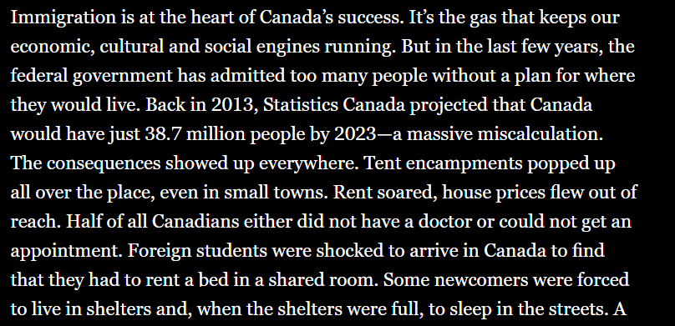
Introduction
June 13, 2024

Slide 22
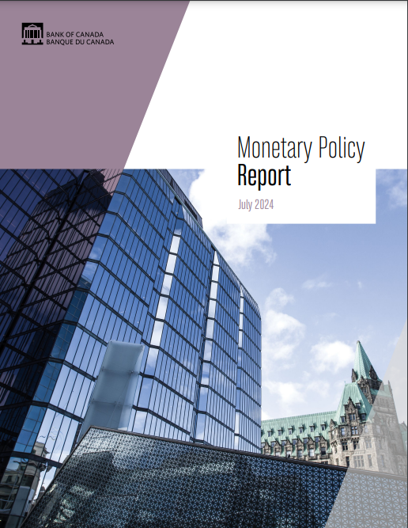

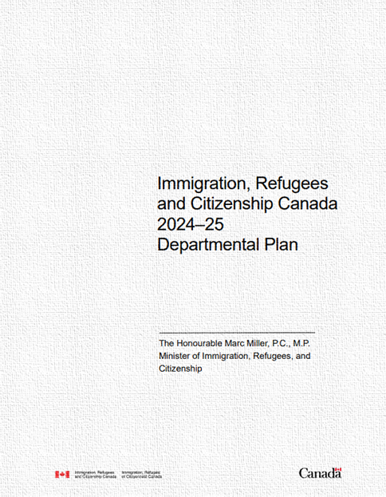
Statistics Canada’s population projections program
 Some use of our projections

Slide 23



Statistics Canada’s population projections program
 Some use of our projections

Slide 24
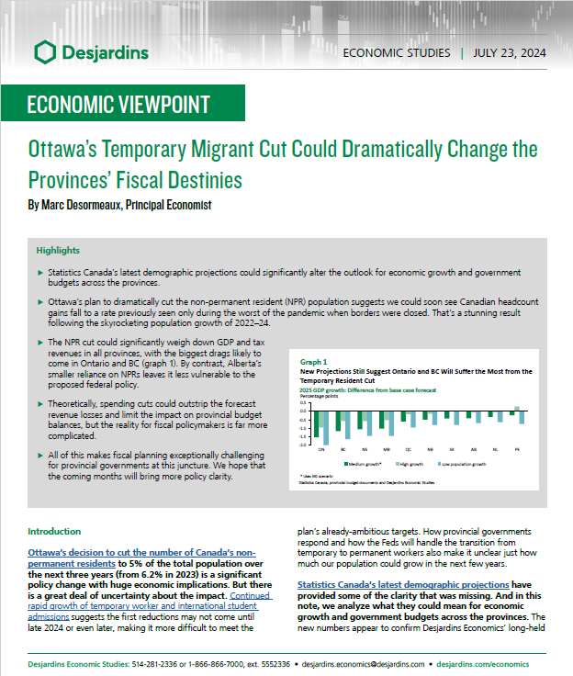
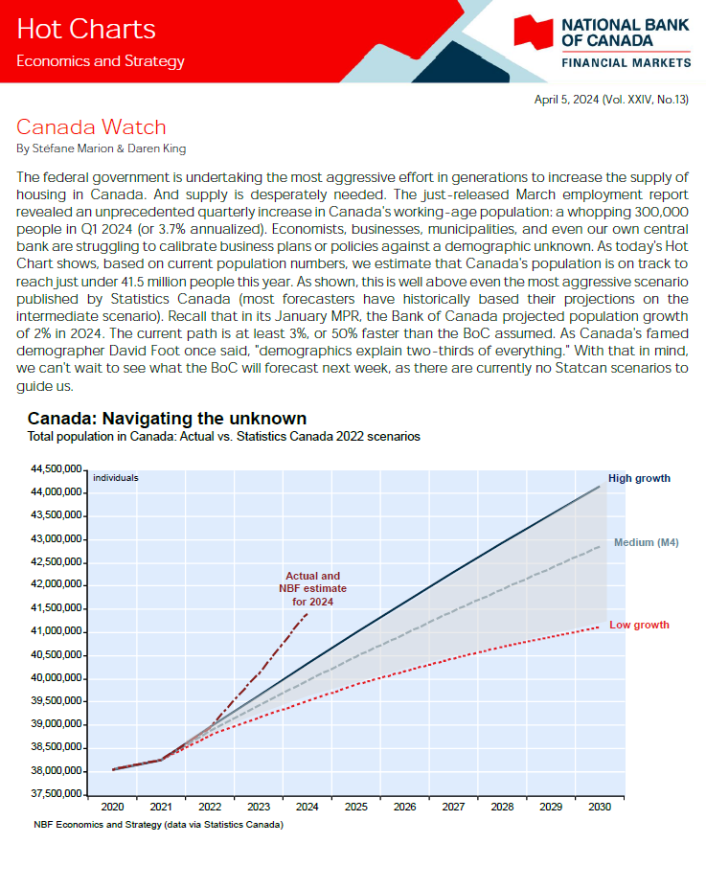
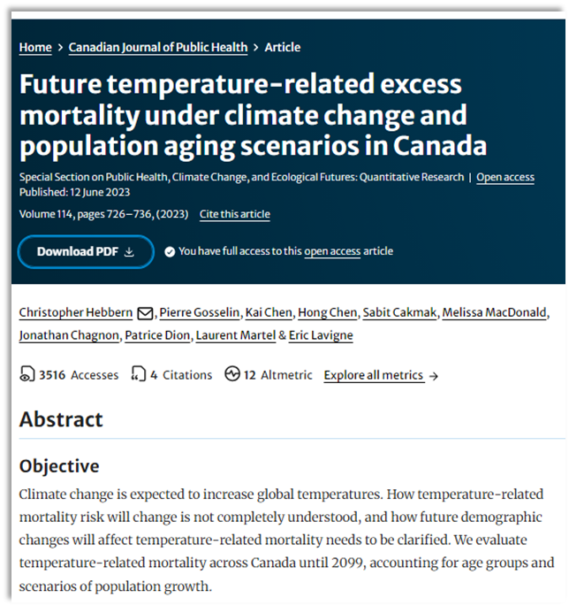
Statistics Canada’s population projections program
 Some use of our projections

Slide 25
Statistics Canada’s Population Projections Program
Three models used
  Cohort component model for provinces and territories, age and gender (or sex at birth) and for custom projections (e.g., various levels of geography, custom scenarios)
  Cohort change model for projections by age and gender of areas with small population counts
  Demosim microsimulation model for sub-provincial areas and multiple characteristics of the population
    Demosim is based on the census long-form questionnaire, adjusted for net undercoverage
    Products available include projections of the ethnocultural diversity, Indigenous populations, linguistic composition, labour force, custom projections, nowcasting exercises, etc.
Projections for provinces and territories updated annually
Multiple assumptions and scenarios available each time
  Assumption building process includes analysis of historical trends, consideration of the Canadian and international context, and use of expert opinion (through a formal expert elicitation process)
The program is a leader in the field of projections among NSOs

Slide 26
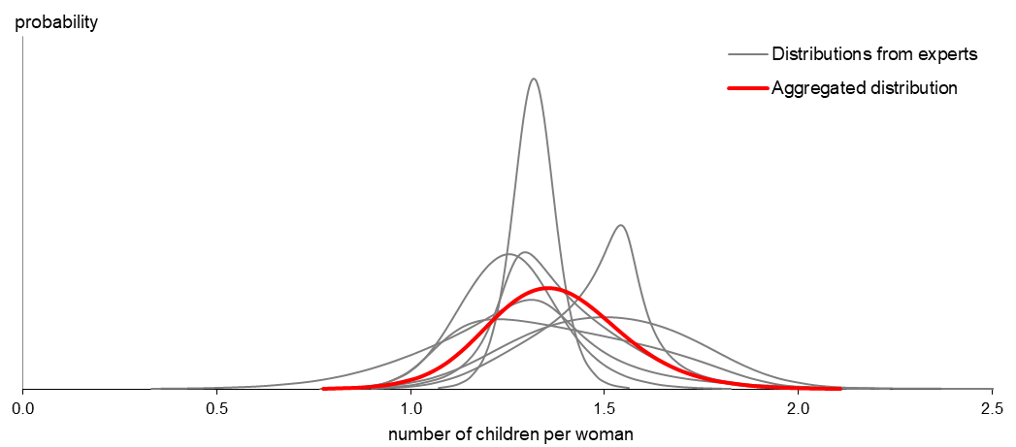
Fertility projections
 Probability distribution for total fertility rate in 2048

Slide 27
Conclusion
 A nation of contrasts
Over the last two years, Canadian demographics have changed:
  Very strong population growth fueled by record-high immigration
  Changes in all components of population growth
  Rapid population aging and changes in the ethnocultural diversity
  Increasing regional differences – urbanisation
Internationally, Canada is an outlier: the population is increasing fast, while growth of the world population is slowing down.
Uncertainty about what’s to come: will some trends that emerged during the pandemic continue?
Demographic estimates from Statistics Canada remain of high quality; methods and data sources need to be evaluated on an on-going basis to keep the program relevant.
Collaboration with partners of the program is critical in this changing environment

Slide 28






Thank you! Please stay connected.
Population and Demography web portal on Statistics Canada’s web site
2021 Census
Demographic estimates
Population projections
  Statistics Canada Website
  The Daily (released at 8:30 am every weekday)
  StatsCAN Plus
  StatsCAN App
%
Questions? Contact us:
STATCAN.infostats-infostats.STATCAN@statcan.gc.ca
statcan.demography-demographie.statcan@statcan.gc.ca

