Slide 1
Prince Edward Island
CSLS-AIPR Session on “The Economic Performance and Outlook for Atlantic Canada: Provincial Perspectives”
Jim Sentance University of Prince Edward Island
June 2021

Slide 2
PEI has been “On a tear”
Led provinces in GDP growth since 2016, by a wide margin
Led provinces in population growth
Led provinces in immigration
Led provinces in employment growth
Continued during Covid

Slide 3
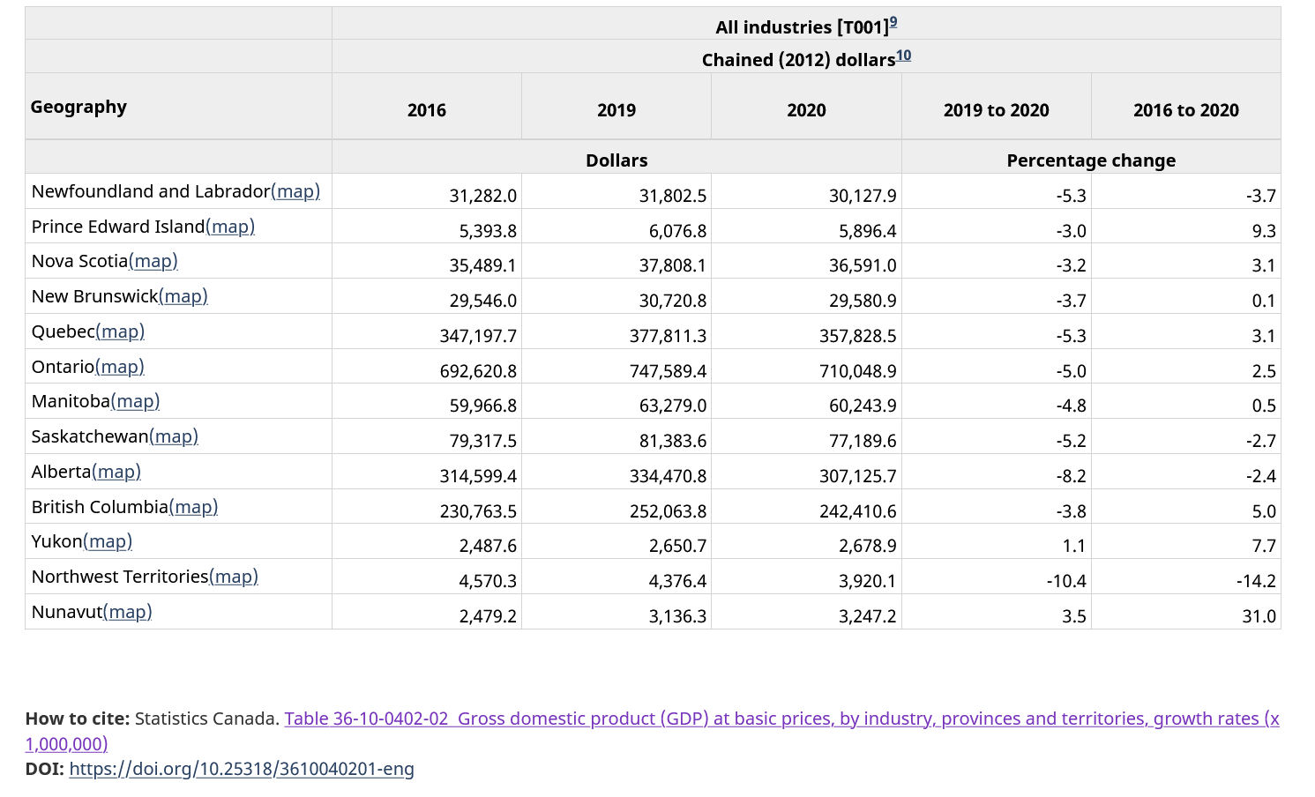

Slide 4
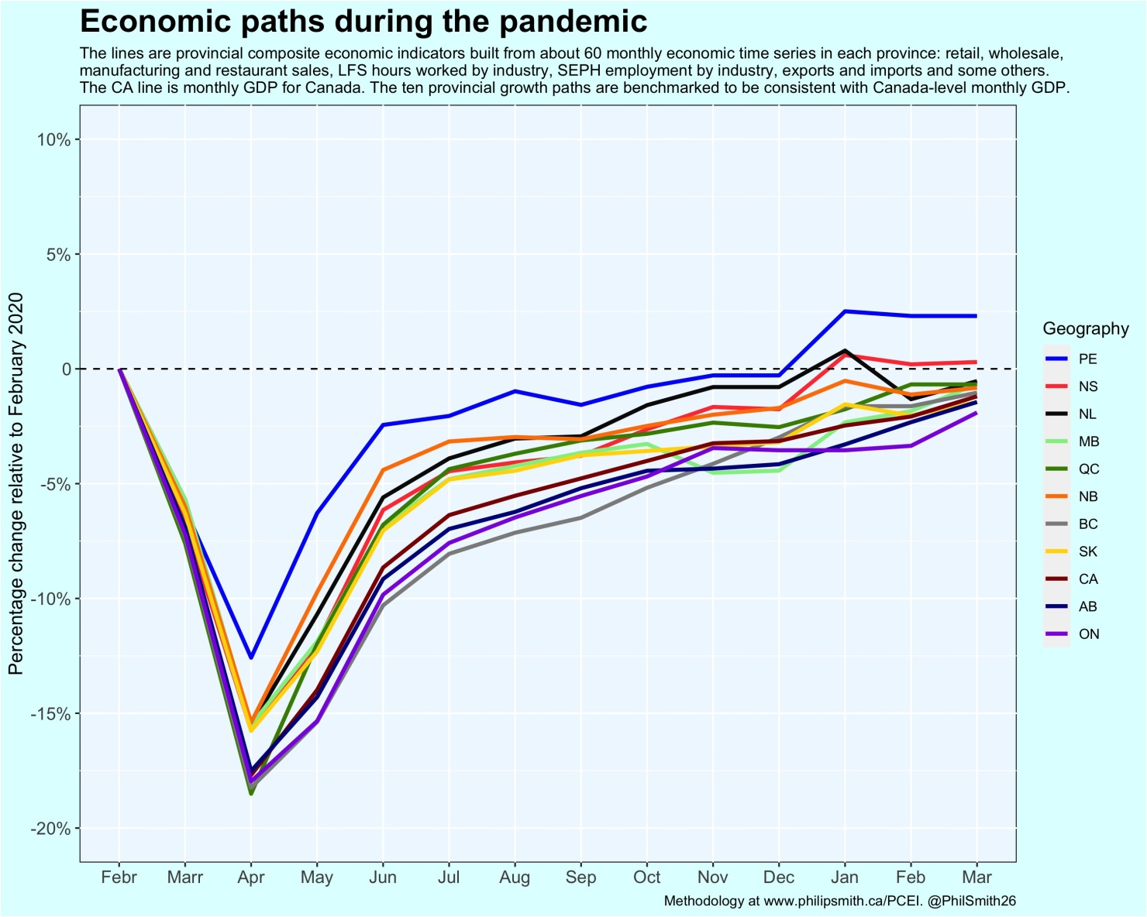
Source: Philip Smith twitter @PhilSmith26

Slide 5
Where is the growth coming from?
Is it sustainable?

Slide 6
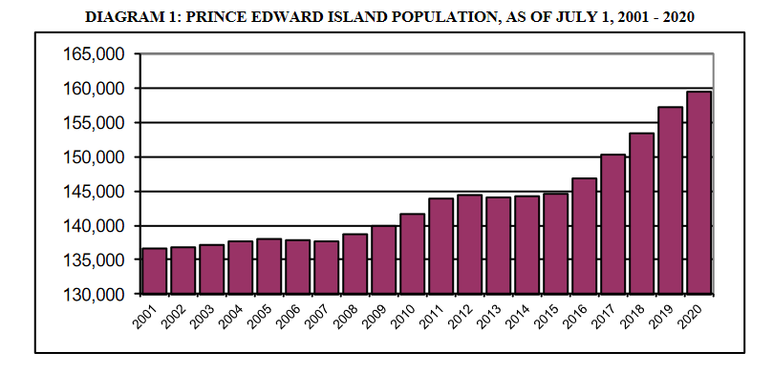
Population Growth
Source: PRINCE EDWARD ISLAND POPULATION REPORT 2020

Slide 7
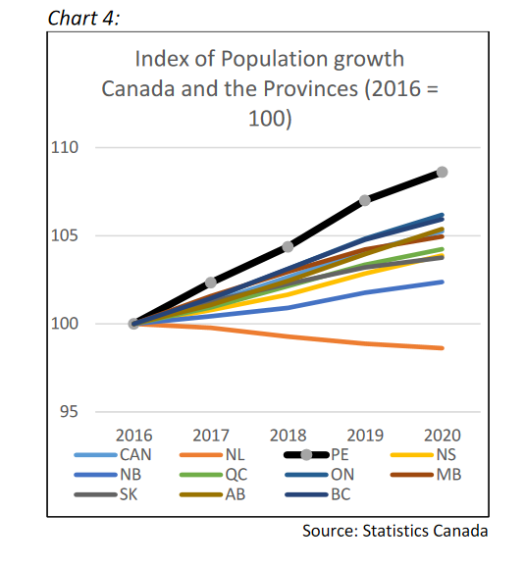
Source: PEI Budget Paper on the Economy 2021

Slide 8
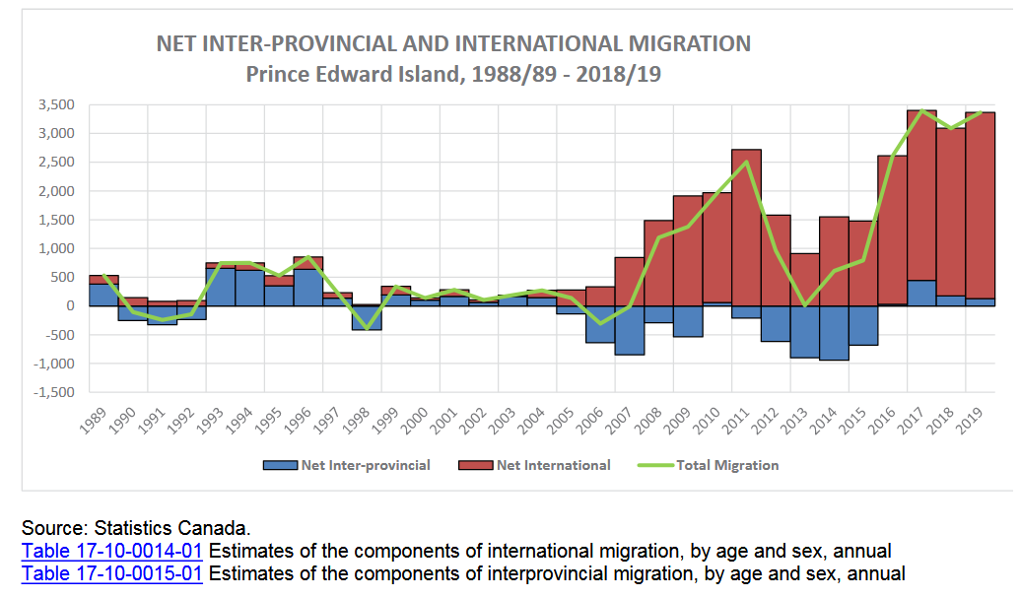
Source: PEI Annual Statistical Review

Slide 9
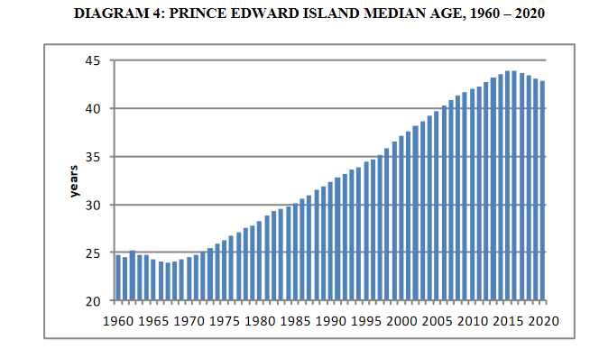
PEI has actually been able to reverse the aging trend
Source: PRINCE EDWARD ISLAND POPULATION REPORT 2020

Slide 10
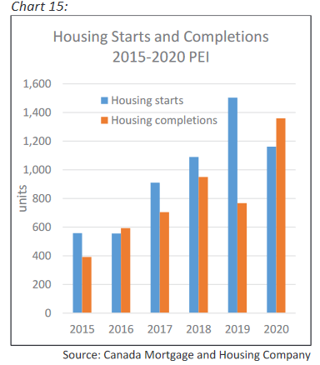
Source: PEI Budget Paper on the Economy 2021

Slide 11
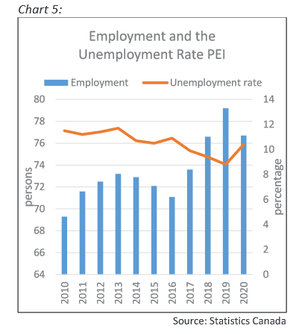
Source: PEI Budget Paper on the Economy 2021

Slide 12
Other factors
HST introduced 2013
Manufacturing growth
Food Branding
Tourism
Stable government finances

Slide 13
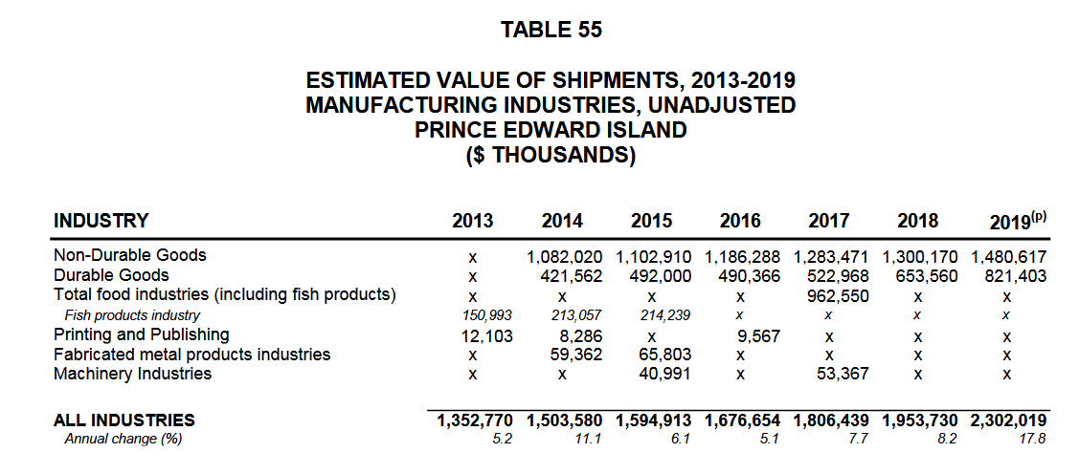
Source: PEI Annual Statistical Review

Slide 14
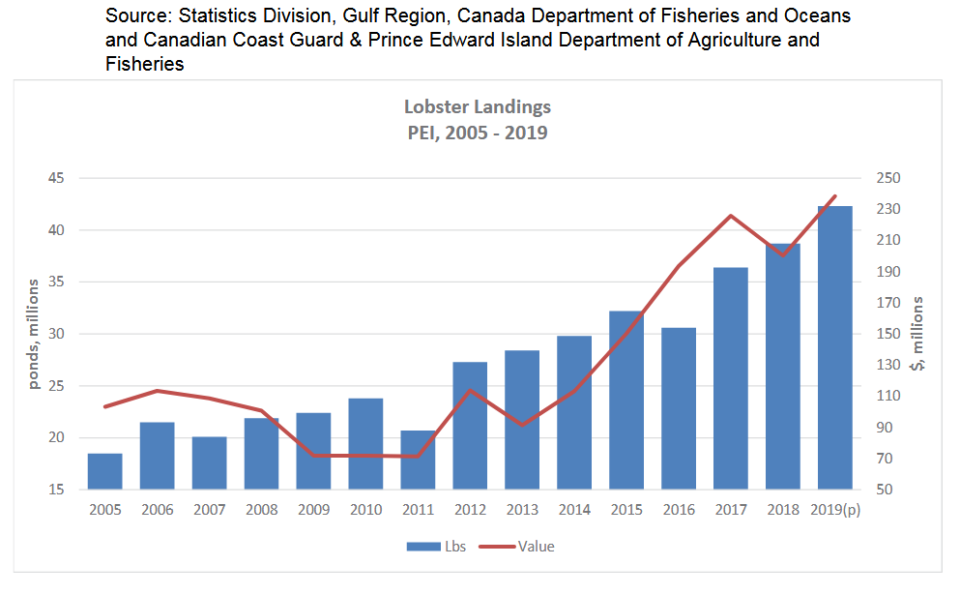
Source: PEI Annual Statistical Review

Slide 15
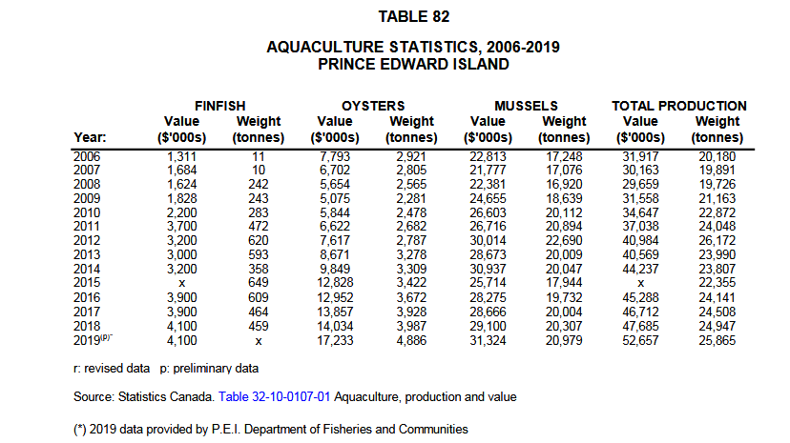
Source: PEI Annual Statistical Review

Slide 16
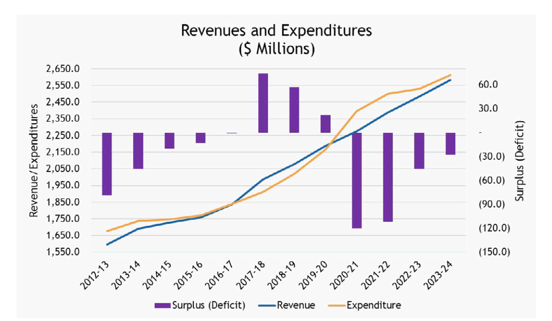
Source: PEI Budget Highlights 2021-22

Slide 17
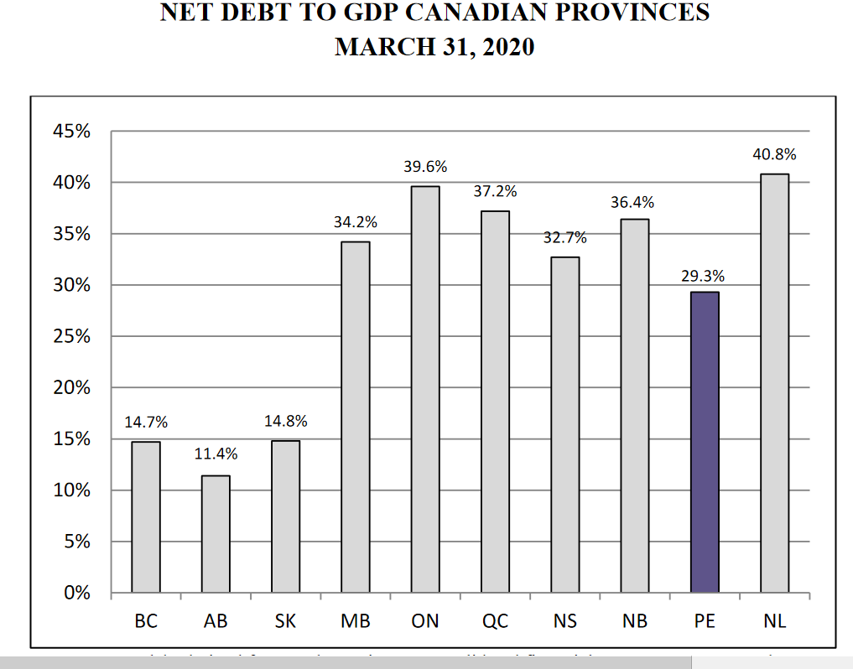
Source: Annual Report 2021 PEI Auditor General

Slide 18
Per Capita Growth not as impressive
Source: PEI Annual Statistical Review

Slide 19
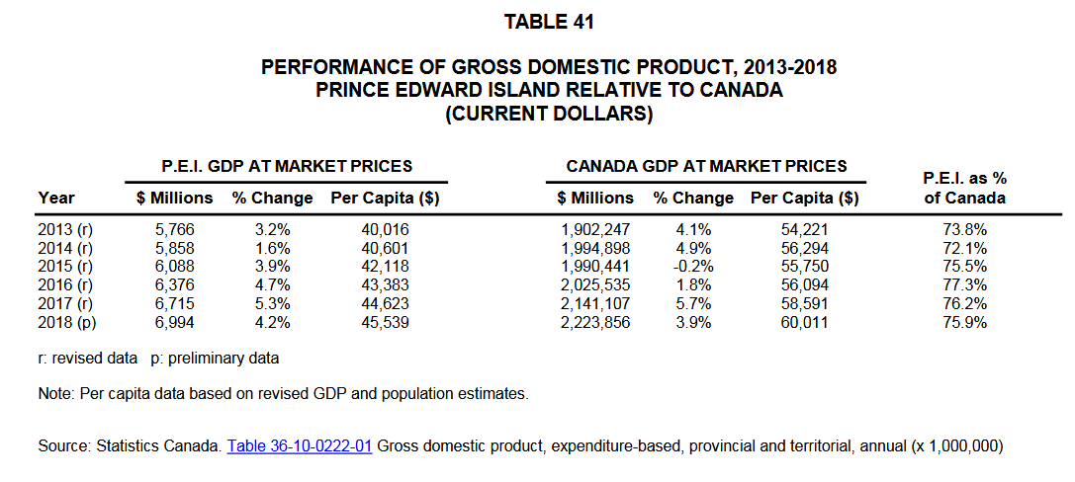
Source: PEI Annual Statistical Review

Slide 20
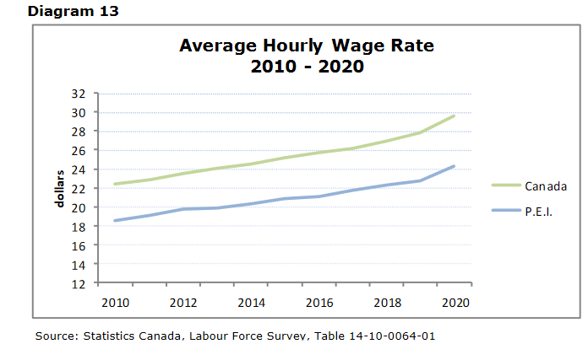
Source: PEI Labour Force Survey Annual Report 2020

Slide 21
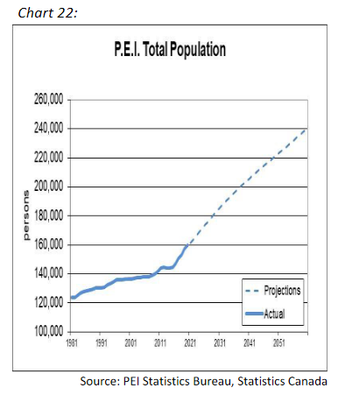
Is it sustainable?
Source: PEI Budget Paper on the Economy 2021

