Slide 1
Comments on “Technology Optimism” by Baily and Manyika
Robert J. Gordon
Northwestern University, NBER, CEPR
San Diego AEA Session, January 4, 2012

Slide 2
Ambiguity: Technology Optimism but
Uncertainty About E and Y Growth
There has been a lot of attention to my “End of Growth” pessimism about the U. S.
Yet the authors’ conclusion is not far from mine.
The problem is: it is possible to be very optimistic about the future of manufacturing productivity growth while very pessimistic about growth of income per capita and especially consumption per capita in the bottom 99% of the income distribution

Slide 3
Optimism About Productivity
Growth in Manufacturing
My bar charts divide the postwar into four periods: 1948-72, 1972-96, 1996-2004, and 2004-12
To understand the optimism about manufacturing, we compare total economy productivity (Y/H) with that in manufacturing and nonmanufacturing.
Subsequently we compare Y/H and Y/N going back to 1891 for the total economy, but with the same postwar break points

Slide 4
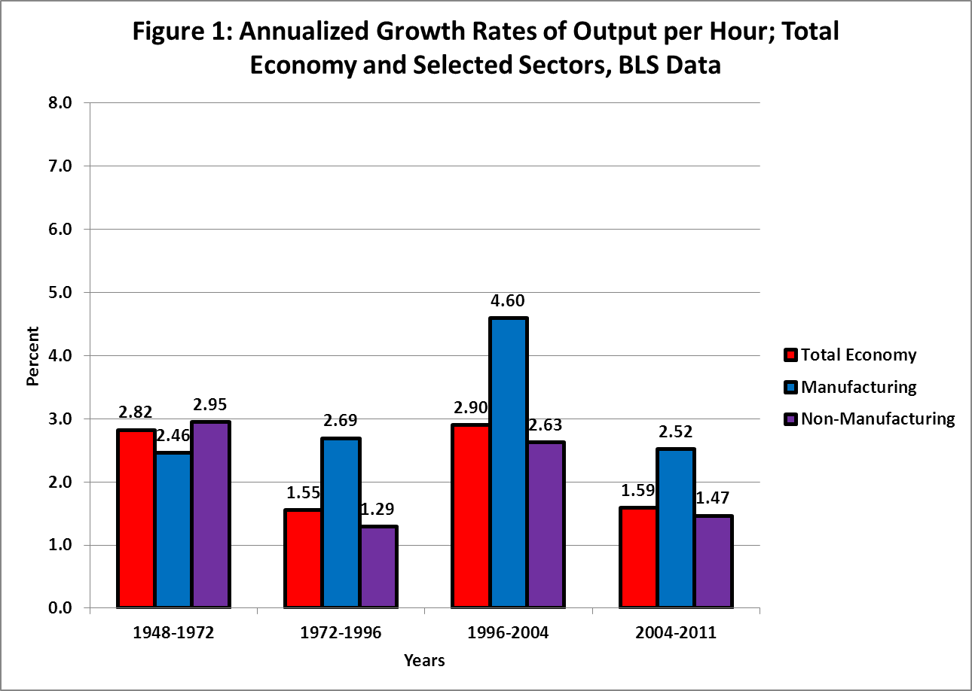
Y/H Growth: Total Economy, Manufacturing, Nonmanufacturing

Slide 5
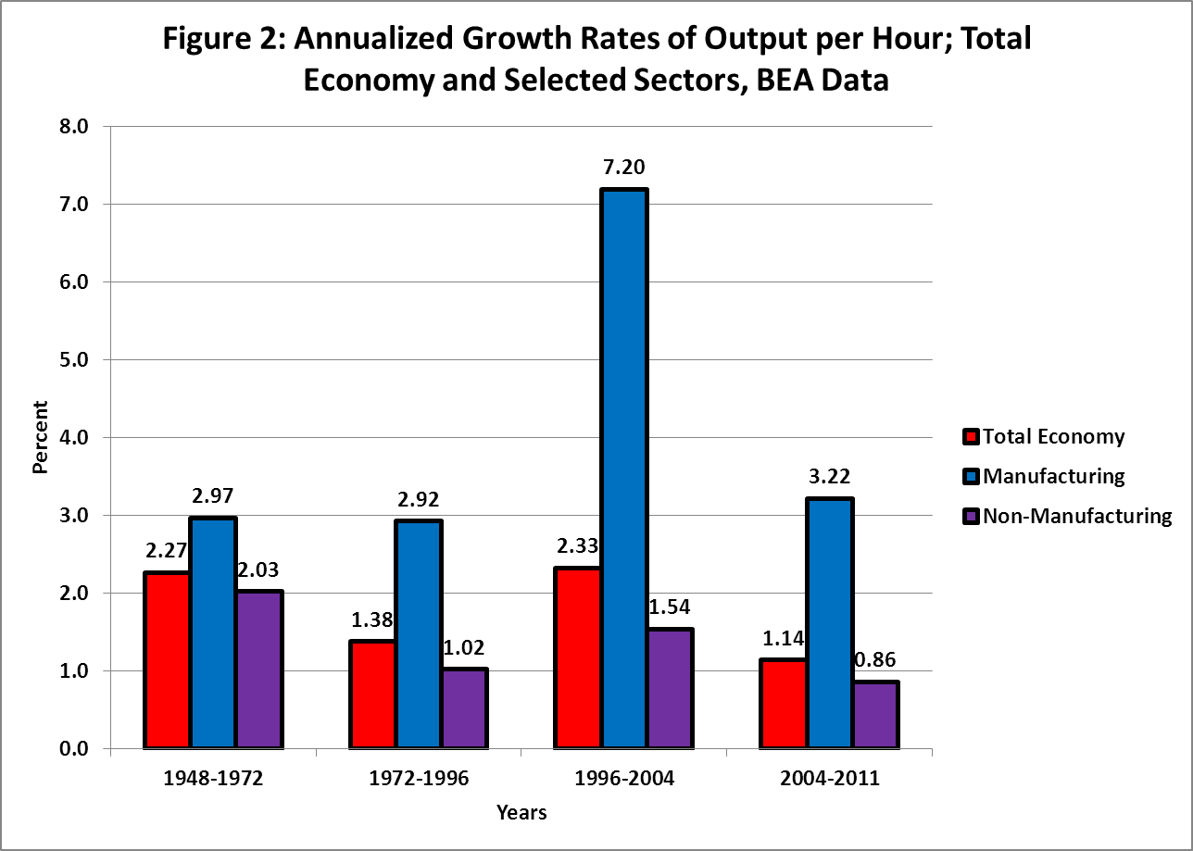
Same with BEA Data on Real Value Added and Hours, Same Scale

Slide 6
Interpretation
BEA and BLS Agree:
  1996-2004 was a historical aberration
  2004-2012 looks just like 1972-96, which we often call the “dismal” slowdown period
  Manufacturing productivity growth 2004-2012 was as rapid as in 1948-72
This nation has many problems, but manufacturing productivity growth is not one of them
Bring on your army of small robots; but remember Krugman. What matters is who owns the robots.

Slide 7
Why Manufacturing Won’t Save Us:
It is Gradually Disappearing
In our national accounts, the impact of growth rates in a given sector depend on its share in nominal value added
As a creator of jobs, the role of manufacturing is expressed by its share of total employment
Both the nominal VA share and employment share of the manufacturing sector have been falling fast and are now respectively 12 and 8 percent.

Slide 8
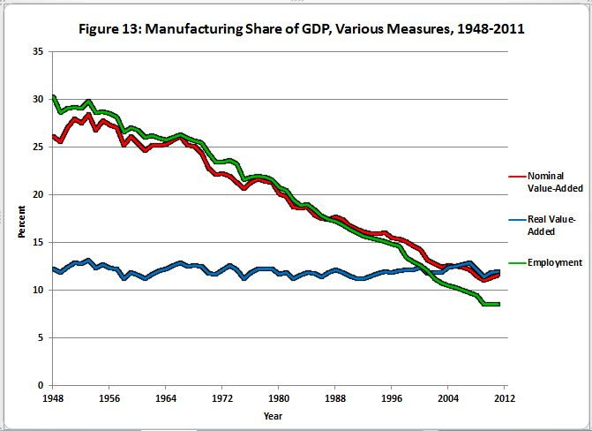

Slide 9
Summary of Uncertainty
About Nonmanufacturing
BLS says 2004-12 = 1.47, up from 1.29 in 1972-96 but half of 2.95 in 1948-72
BEA says 2004-12 = 0.86, down from 1.02 in 1972-96 but less than half of 2.03 in 1948-72
Our productivity problem is in nonmanufacturing and evokes Zvi Griliches’ “hard to measure” 1994 AEA Presidential Address

Slide 10
The Total Economy, 1891-2012, for both Y/H and Y/N
Central Identity: Y/N ≡ Y/H * H/N
Throughout most of history, H/N declined as economic agents chose to enjoy higher Y/N in part as leisure, shorter hours, longer vacations.
The big exception was 1972-96, dominated by female entry into the labor force, which raised H/N and partially buffered Y/N from the Y/H slowdown
Relative optimism about productivity (Y/H) in the last decade is tempered by the dismal performance of H/N.

Slide 11
2.0 Anchors Our Thinking
Real GDP per capita grew at 2.02 percent between 1891 and 2007.
  2.20 for Y/H, -0.18 for H/N.
In my interpretation the 2.0 was propelled by the 2nd industrial revolution and all its spinoffs, 1891-1972
Then the early decades of the computer revolution (IR #3), replaced many dreary clerical tasks by computer-related machines
My prediction is that over the next few decades that 2.0 number falls to 1.0, and to 0.5 for the bottom 99%

Slide 12
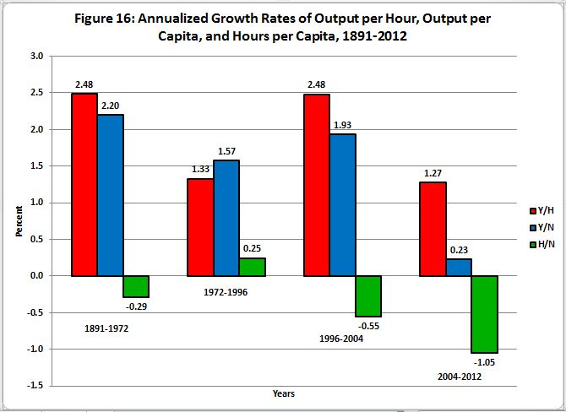

Slide 13
The Authors Agree: Growth in Output per Capita is Grinding to a Halt
The paper’s initial slide shows projected 40-year increases in real per-capita GDP (Y/N)
Birth year 1960: 2.33 percent per year
Birth year 2000: 1.22 percent per year
This is close enough to my pessimistic view that I can adopt Baily and Manyika as teammates.

Slide 14
There are Many Reasons to be Pessimistic About Future Y/N Growth
There are at least 7, but here I’ll focus on only three
Demography, Education, and Inequality
Why have hours per capita grown so slowly?
  Decline of 7% 2000-2004, no recovery, further decline of 8% 2004-2012
  Baby-boom retirement
  “The Missing Fifth”; Charles Murray’s “Fishtown”
  Youth entering higher education but then dropping out, especially at community colleges

Slide 15
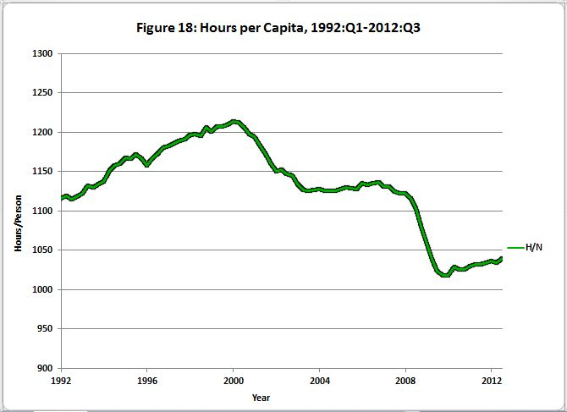

Slide 16
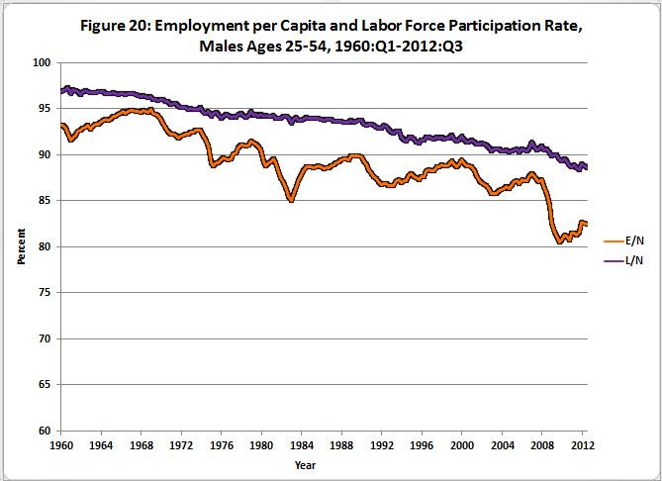

Slide 17
The Dismal State of American Education
Tertiary education completion among 25-34 year olds: U.S. 41%, Canada 56%
$1 trillion in student debt
U.S. ranked #21 of #26 OECD countries in high school graduation rates
85% of foreign exchange students say that their American high school classes are much easier than in their native countries
The black-white gap has not narrowed since the 1960s and the social negatives of the bottom 30% of the white income distribution (Murray’s Fishtown) are at levels chronicled in the 1965 Moynihan report.

Slide 18
The Stark Saez Statistics on Inequality
1993-2008: AVERAGE real income growth = 1.3 percent per year.
Same period: same concept for the bottom 99% grew at 0.75 percent a year.
There is no reason why this increase in inequality will not continue for the same reasons as before
This is why I mark down my forecast of 1.0 percent future Y/N growth to 0.5 percent for the bottom 99%

Slide 19
Conclusions
All this talk about small robots and “big data” is not going to save us.
Productivity growth in manufacturing can continue to chug along at 3% (BEA) or 2.5% (BLS)
But transition to the total economy for Y/H
Then transition from Y/H to Y/N
Run it through the six headwinds
And we’ll be lucky to achieve growth in income per capita of the bottom 99% of 0.5% for decades into the future

