Slide 1
Is the Information Technology Revolution Over?
By David M. Byrne, Stephen D. Oliner, and Daniel E. Sichel
2013 ASSA Meetings
Discussant: Chad Syverson

Slide 2
Overview
Paper’s analysis has three main parts:
Decomposition of LP growth into IT and non-IT components and comparison between 1995-2004 and 2004-2012
Prediction of steady state LP growth going forward
Re-assessment of potential IT-driven growth in light of evidence from semiconductor manufacturing

Slide 3
1. LP Decomposition: Is a Productivity (Re-) Slowdown Historically Unprecedented?
The prior GPT diffusion event was the electrification (& plumbing) era
Medium-run LP trends were not altogether different at that time

Slide 4
1. LP Decomposition: Is a Productivity (Re-) Slowdown Historically Unprecedented? No.

Slide 5
1. LP Decomposition: Is a Productivity (Re-) Slowdown Historically Unprecedented? No.

Slide 6
1. LP Decomposition: Is a Productivity (Re-) Slowdown Historically Unprecedented? No.
Period | Annual Avg. LP Growth (%) | Period | Annual Avg. LP Growth (%)
1896-1915 | 1.0 | 1976-1995 | 1.4
1915-1924 | 3.3 | 1995-2004 | 3.1
1924-1932 | 1.0 | 2004-2012 | 1.6
1932-1940 | 2.7 | 2012- | ?

Slide 7
2. Predicted Steady-State Future LP Growth
Forecasting is hard
Average future growth rates are hugely important
But recent patterns have convinced me median growth matters a lot too
  Forget normative issues—even positive implications will be inescapable if pattern of past 3 decades continues

Slide 8
2. Predicted Steady-State Future LP Growth

Slide 9
3. Intel and Semiconductor Innovation: A More Pessimistic View
Authors: semiconductor mfg. technology cycle hasn’t slowed
Lithography process generation has held at ~2 years since 1993
Intel’s CPU cycle has held up similarly
However, Pillai (forthcoming): while transistors per unit area have continued to increase, chip designers have not been able to fully harness these improvements
NYT, 9/1/09: “The computer industry has a secret. Yes, the number of transistors on modern microprocessors continues to multiply geometrically, but no one really knows how to get the most out of all these new transistors.”

Slide 10
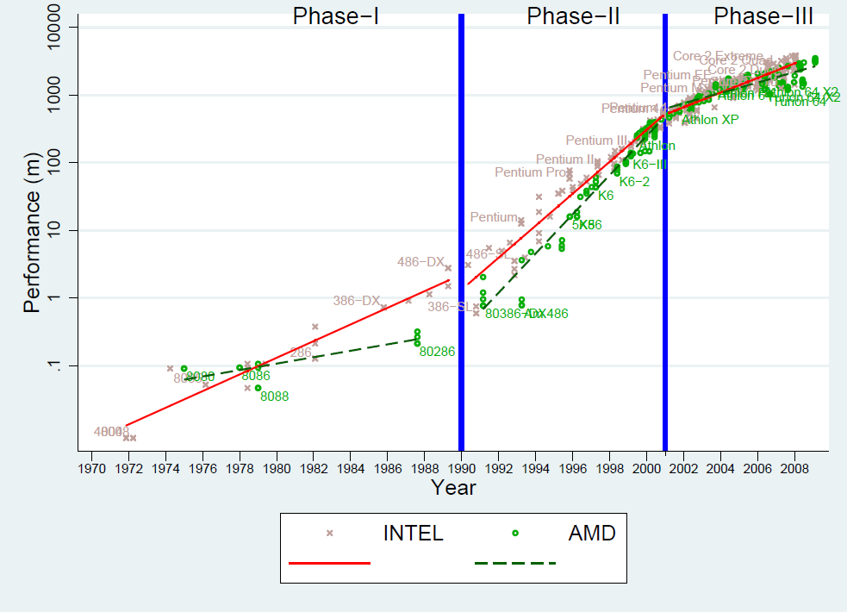
3. Intel and Semiconductor Innovation: A More Pessimistic View

Slide 11
Wrap-Up
Thought-provoking paper: critical issues at hand

